Slide 1
FINAL PROJECT JCL, COBOL & DB2
PRESENTATION BY: THALLURI MOSES

Slide 2
HLCOB01
EXTRACT HOUSING LOAN DATA FROM LOAN_DB,PAYMENT_DB
CHECK DIFFERENCE OF DATE BETWEEN THE NEXT REPAYMENT DUE DATE AND AMOUNT PAID DATE.
If DAYS > 30
SORT THE PS FILE
BACKUP THE SORTED FILE TO GDG
WRITE THE RECORDS INTO CSV FILE & PS
If DAYS > 36
UPDATE THE LOAN DB & PAYMENT DB WITH NEW CURRENT BALANCE
PROVIDE DISCOUNT OF 500 IN CURRENT BALANCE

Slide 3
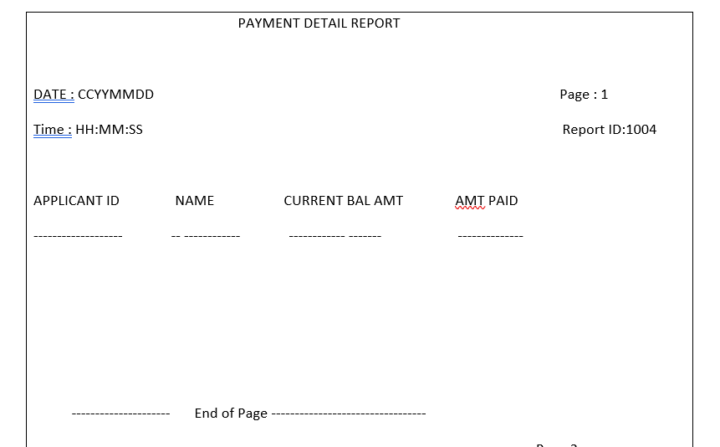
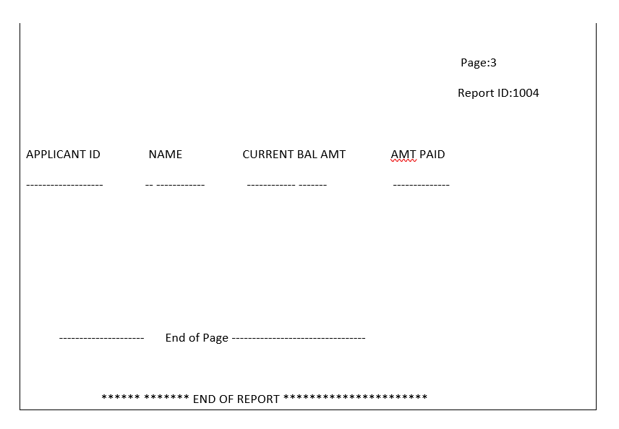
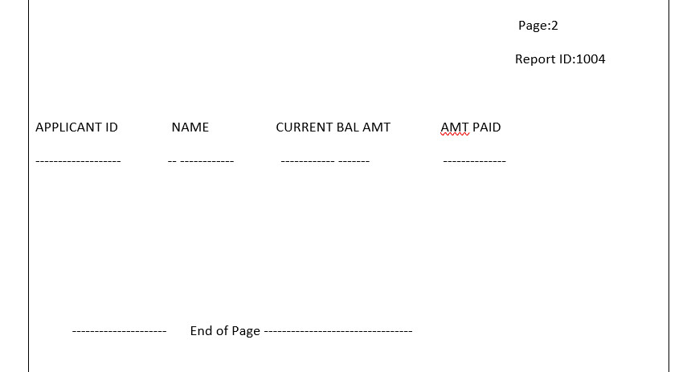
HLCOB02
EXTRACT HOUSING LOAN DATA FROM LOAN_DB,PAYMENT_DB & APPLICANT DP
IF CURRENT BALANCE IN PAYMENT_DB IS LESS THAN 1000
GENERATE A SEPARATE REPORT FILE USING PAGE BREAK LOGIC

Slide 4
HLJCL01
STEP 1
STEP 2
STEP 3
TAKE INPUT PS AND SORT TO OUTPUT PS
DEFINE GDG CLUSTER
BACKUP RECORDS FROM SORTED PS TO GDG

Slide 5
OPEN
OUTPUT FILES AND CURSOR
OPENS AND OUTPUT PS AND CSV FILE AND CURSOR TO RETRIEVE DATA
FETCH
FETCH RECORDS FROM TABLES
FETCHES RECORDS FROM TABLE INTO HOST VARIABLES BASED ON THE SELECT CONDITION
CSV
WRITES THE RECORDS INTO CSV FILE
CHECKS IF DAYS ARE GREATER THAN 30 IF GREATER THAN 30 WRITES TO CSV PS FILE
PROGRAM TERMINATES IF OPEN FAILS
PROCESS
THE RECORDS
CALCULATES DIFFERENCE OF DATE BETWEEN THE NEXT REPAYMENT DUE DATE AND AMOUNT PAID DATE.
UPDATE
UPDATES LOAN AND PAYMENT DB
UPDATES LOAN AND PAYMENT DB BY PROVIDING DISCOUNT OF 500 TO ELIGIBLE APPLICANTS
CLOSE
OUTPUT FILES AND CURSOR
CLOSES CURSOR , OUTPUT PS AND CURSOR
TERMINATE
THE COBOL PROGRAM.
CONVERTS THE DATES INTO INTEGER DATE FORM (NO. OF DAYS FROM 31/12/1600)
IF DAYS ARE GREATER THAN 30 IT WRITES THE RECORDS INTO SORT PS FILE.

Slide 6
OPEN
OUTPUT FILES AND CURSOR
OPENS REPORT FILE AND CURSOR TO RETRIEVE DATA
FETCH
FETCH RECORDS FROM TABLES
FETCHES RECORDS FROM TABLE INTO HOST VARIABLES BASED ON THE SELECT CONDITION
RECORD
ARE MOVED INTO LAYOUT
DATA IS MOVED INTO OUTPUT LAYOUT
PROGRAM TERMINATES IF OPEN FAILS
CHECK
THE CONDITIONS AND CREATES LAYOUT
WRITE
THE RECORD INTO REPORT PS
WRITES THE RECORD TO OUTPUT PS WHENEVER CALLED
CLOSE
OUTPUT FILES AND CURSOR
CLOSES CURSOR , OUTPUT PS AND CURSOR
TERMINATE
THE COBOL PROGRAM.
CHECK FOR CONDITIONS LIKE PAGE NUMBER, LINE COUNT AND SQL CODES
MOVES THE HEADERS AND TRAILERS LAYOUT INTO THE OUTPUT LAYOUT VARIABLES
WRITES THE HEADERS AND TRAILERS INTO OUTPUT

Slide 7
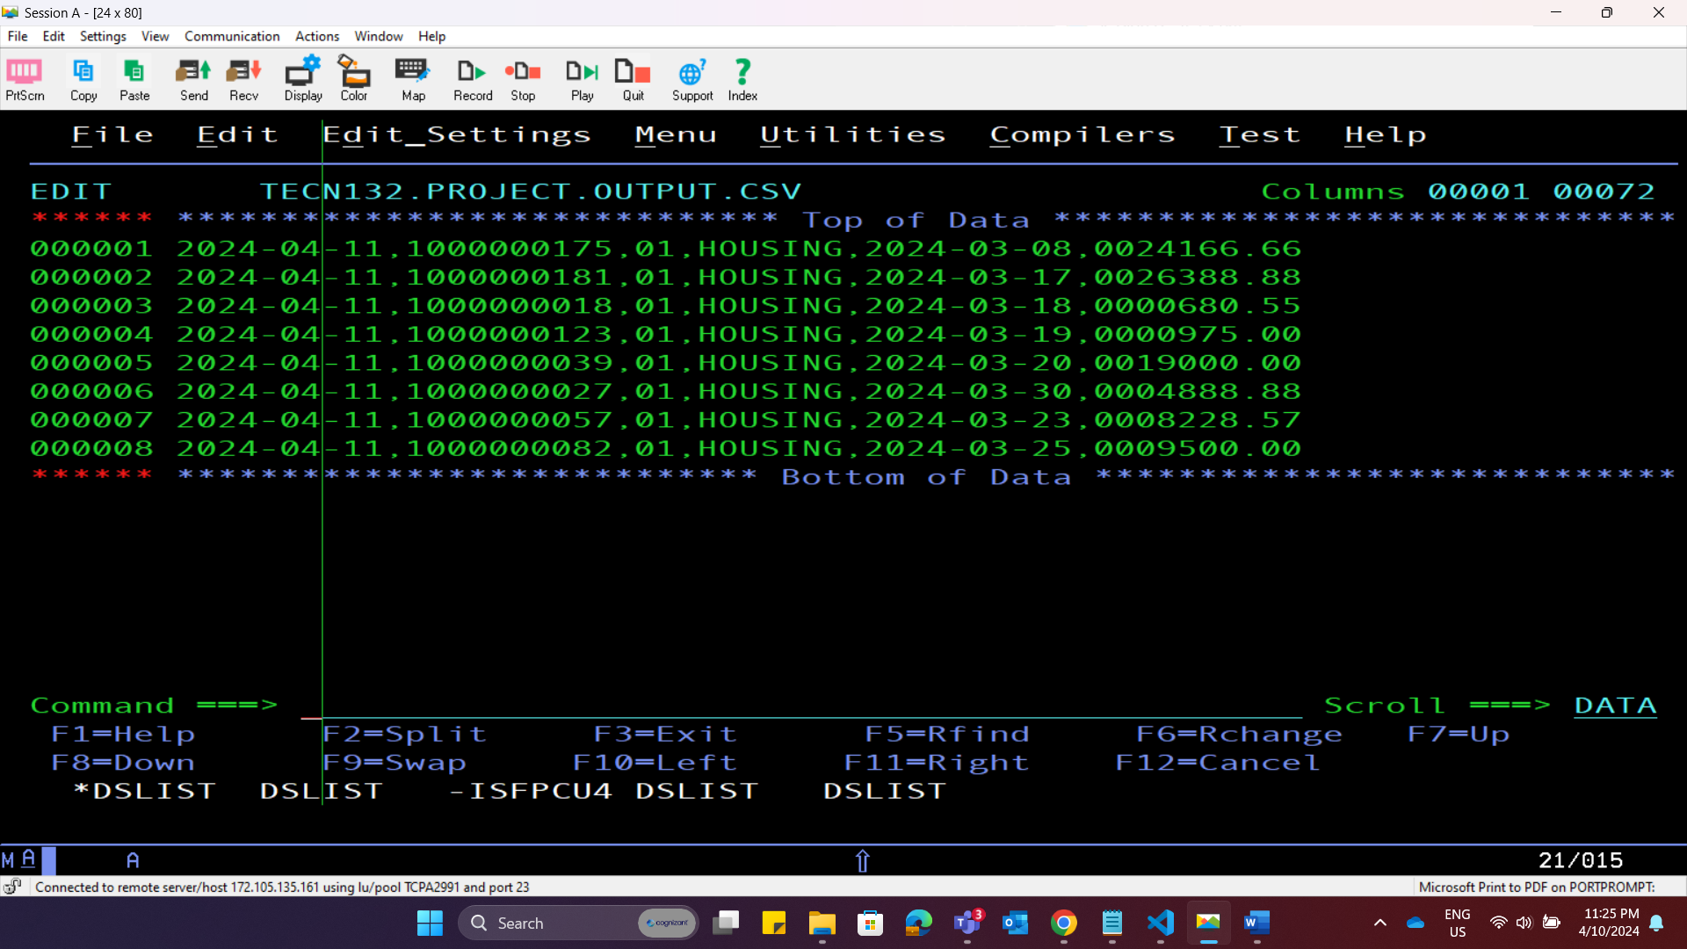

Slide 8
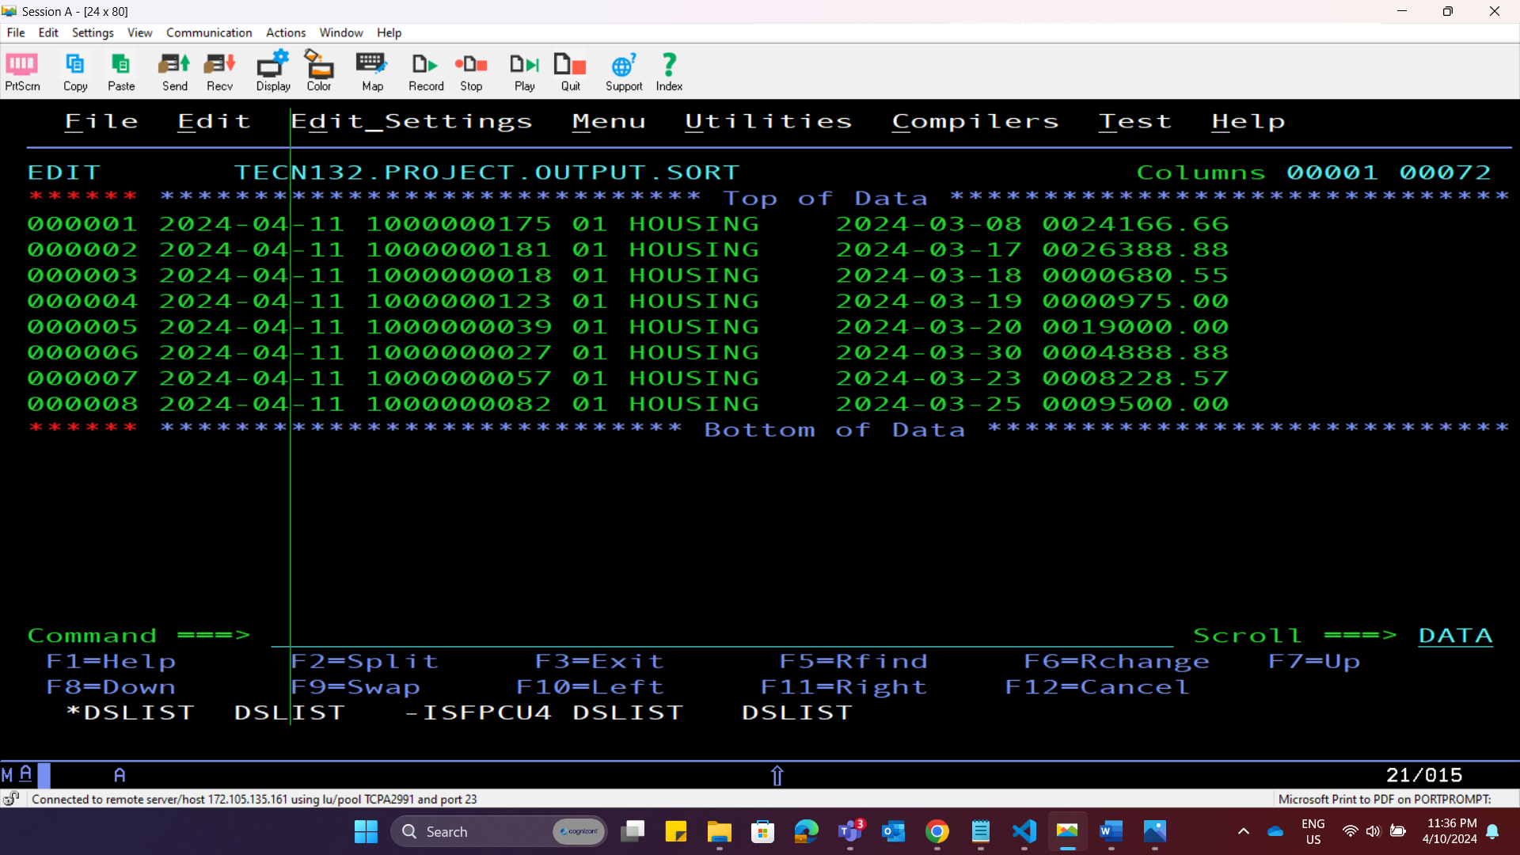

Slide 9
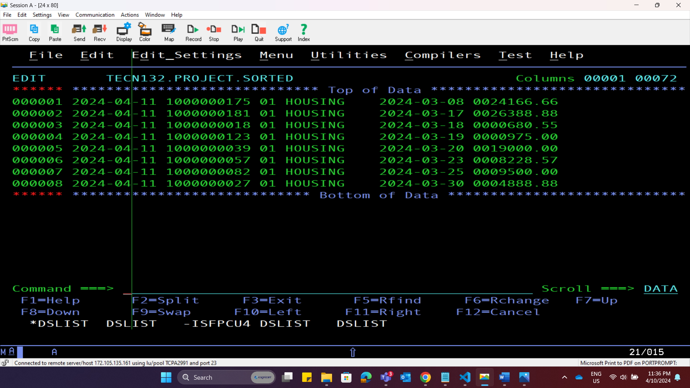

Slide 10
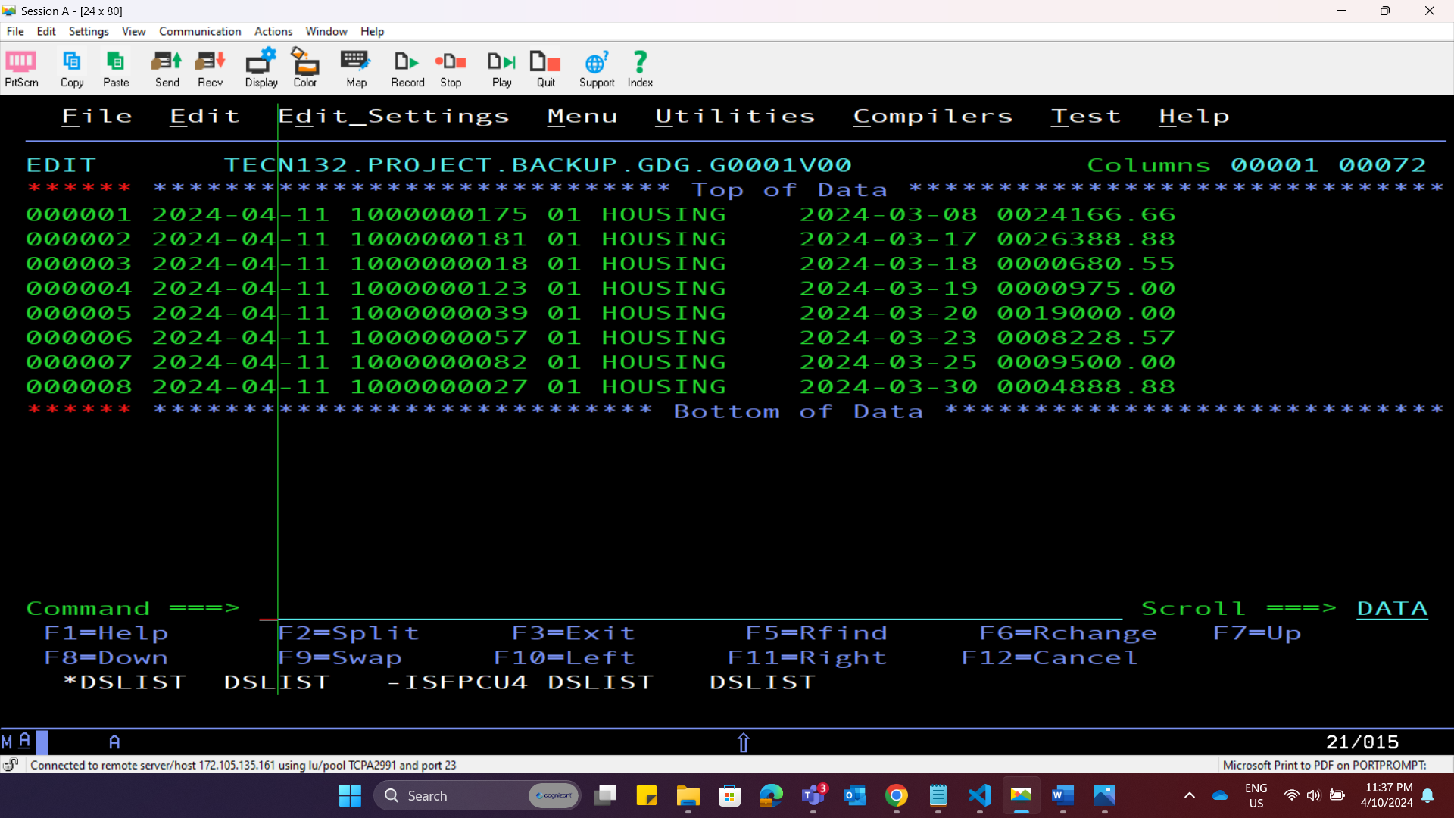

Slide 11
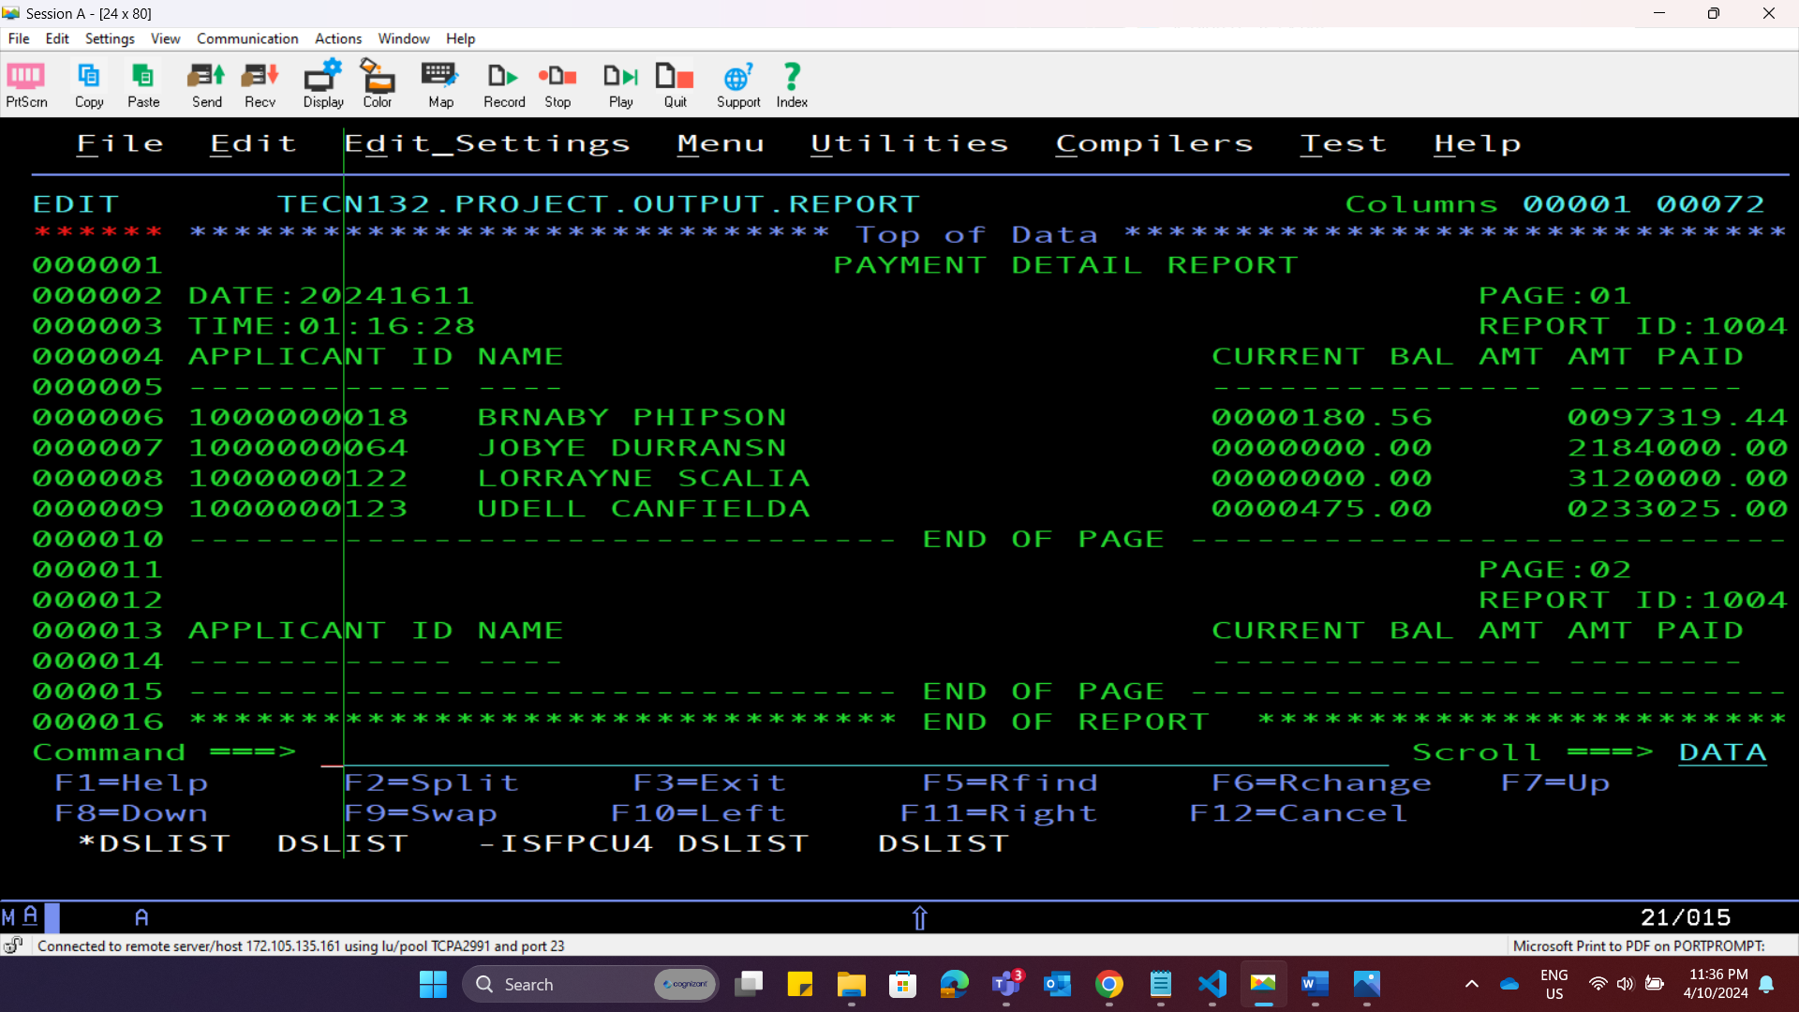

Slide 12
THANK YOU

